Slide 1
HCC Totality Training | Data Review and Deletion

Slide 2
TOTALITY | Data Review and Deletion
Supplier Upload Review:
Suppliers are required to review all uploaded data (including templates and supporting documents) for completeness and accuracy, and to ensure that there are no duplicates, and that data is accurate for Federal and State reporting.
Data Deletion:
The HCP data deletion request is processed to remove duplicate and incorrect information that were submitted.
In the event that inaccurate or duplicate data is identified, suppliers are required to submit a data deletion request and reupload any corrected data.
Internal User – Go to slide 4 for further process; Vendors – Go to next slide (Slide 3)
Notes:
Update

Slide 3
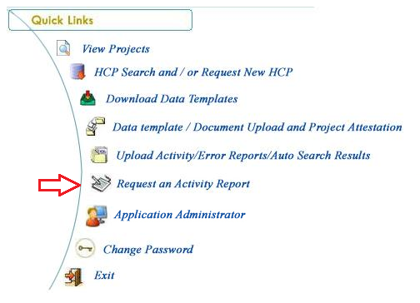
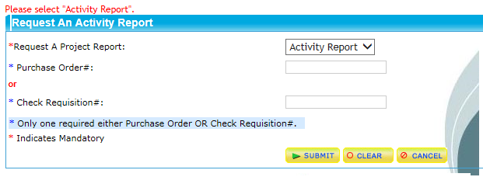
TOTALITY | Data Review and Deletion | External
“Request an Activity Report” for the project and review to validate that all uploaded HCP data is complete and accurate.
Here are the instructions to run the activity report on Totality Extranet for Suppliers/Vendors.
Click Request an Activity Report
Insert the Purchase order or the Check Requisition number.
Click “Submit” to run report.
An Activity Report that provides the details of all validated upload activity (and documents) for the project will be emailed to the User within 1 hour.
Jump to slide 5 for further process
Notes:
Update

Slide 4
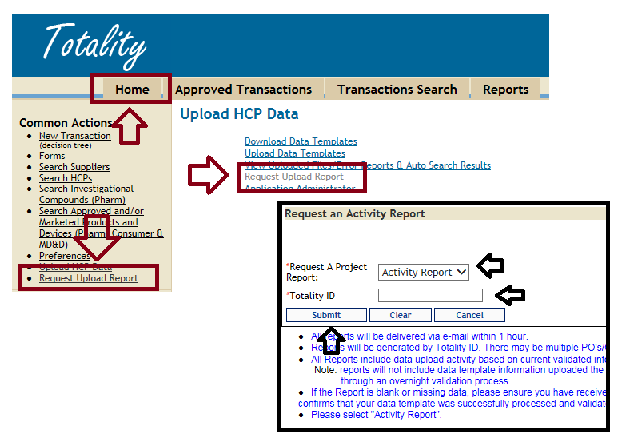
TOTALITY | Data Review and Deletion | Internal
“Request an Activity Report” for the project and review to validate that all uploaded HCP data is complete and accurate.
Here are the instructions to run the activity report on Totality.
Insert the Totality number and click “Submit”
An Activity Report that provides the details of all validated upload activity (and documents) for the project will be emailed to the User within 1 hour.
Notes:
Update

Slide 5
TOTALITY | Data Review and Deletion
If errors or duplicate records are identified on the report, complete the attached Data Deletion Request Submission Form (Columns A – L).
The information needed to complete the form (i.e., File Name, File ID Number and Record Number of each line to be deleted) can be found in the columns at the end of the Activity Report.
Notes:
Update

Slide 6
TOTALITY | Data Review and Deletion
Contact the helpdesk on the number 1-855-561-4747 with the completed Data deletion form.
Select the language that you prefer to communicate in.
The voice prompt will then ask to enter your WWID (world wide ID)
Internal Users enter your WWID
External Users enter “0”
Then choose option 4 for Business Application Support after listening to voice prompt; this will connect to Helpdesk assistant, Who will assist in creating a ticket and also confirm where to submit the data deletion form.
Once the data deletion process is completed by the helpdesk assistant; the requestor will receive a confirmation email about the completion.
Upon receipt of the email confirmation, the supplier/requestor must re-run the Activity Report to validate the accuracy of the Final data.
Notes:
Update

Slide 7
TOTALITY | Resources: J&J Totality Experts
Totality Process Related Questions:
Rebecca Shephard
RShephe1@ITS.JNJ.com
Benson Thomas
bkoipal1@its.jnj.com
609-730-4575
Totality Project Related Questions:
Your J&J Totality Project Manager
J&J Extranet Resources:
Supplier Totality Portal: https://totalitygateway.jnj.com/tpextranet/
Supplier Resource Portal: http://www.totalitygatewayresources.com/
Notes:
Update

Slide 8
THANK YOU

